Slide 1
Villa Montessori Charter School Sarahfina’s Parent Orientation

Slide 2
Outline for Parent Orientation
Contact information
Montessori Outcomes
Growth and Independence
Supply List
Schedule
Cultural Area of Study
Google Classroom
Homework
Summer/Math/Long Term Projects
Reading
Classroom Notes
Frequently Asked Questions
Pizza Friday

Slide 3
Contact Information
Villa Montessori – Davis Campus: Elementary 2-Room 212
2828 E. Meadowbrook Ave. Phoenix, Arizona 85016
Main Office Telephone Number: (602) 955-2210
Main Office Fax Number: (602) 957-4017
Absentee Line: (602) 955-2210
Head of School: Margo O’Neill: moneill@villamontessori.com
Elementary Director: Christy Cantu: ccantu@villamontessori.com
School Website: www.villamontessori.com
Classroom Website: This is how I keep parents up-to-date on class news and announcements. https://sarahfinavilla.weebly.com/
E-Mail: sfore@villamontessori.com
E-mail is the best way to contact me. I will do my best to reply within 48 hours.
Assistant: “just” Ren
Parent Coordinator: : Sarah Sullivan: tiasarah@gmail.com

Slide 4
Montessori Outcomes
Encourage Independence – let your child advocate for him/herself by messaging or talking with the teacher directly.
Learning is happening all the time. Provide a study space/learning environment at home that is free of distractions. Taking breaks, being outside, and being active are also important to learning.
Developmentally, social conflicts are normal at this age. Courageous Conversations have been implemented to encourage resolution between students, staffs and community members.

Slide 5
Growth and Independence
Growth and Independence of the E2 Student:
One goal of Montessori learning is independence of the child so, we will be working continuously on concepts and activities that help your child begin their transition into adolescence and being independent young adults.
"Independence is one of the most important ideas in Montessori philosophy. Allowing your child to do activities and work on their own (i.e. caring for themselves, their environment, their home responsibilities) breeds self-confidence, self-awareness, and independence."
Montessorians believe that you should never do for a child what they can do for themselves. As a parent, I am aware that in the home environment this philosophy is not always easy nor timely. However, when we can give children a chance to act independently, we should. When parents interfere with a child’s independence, they become an obstacle in their education and development. We are sending the message that they are not capable, which can significantly inhibit their confidence and growing sense of independence. When life allows, it is important to let children make their own sandwiches, cook with us, and care for their environment, even if they must face failures and mistakes.
Below are two ways you can foster independence at home with your child.
Children should be making their own lunches. This may take some getting used to so you may want to use the next few weeks to start planning what that looks like. I encourage the children to do this work the night before class so they aren't rushing in the morning before arriving at school.
Children could have a monthly home project of planning, budgeting, shopping and preparing a meal. They should document the process and then share with the class (or just myself) how they had a budget, how they delegated tasks to family members, and how successful their meal turned out.

Slide 6
Supply List
 | Community Supplies *If you are able , please bring each of these items to be shared by all students* (1) bag of topsoil OR seeds to plant in our garden (1) 3-Pack of Clorox Wipes OR paper towels (1) Pack of graph paper (1) Pack of lined paper (2) Pack of Pencils *Optional* – Gift card to Target, Home Depot, Michaels, Amazon, or Walmart
Individual Student School Supplies
Binder – 1 ½ inch, white, view front and back
(This will be used for Portfolios)
(1) 5 subject spiral notebook (3 hole punched with pockets)
Each section will labeled the following
Science
History/Geography
ELA
Grammar
Novel Study
(2) Composition books
This will be used as our daily planner
(1 ) Spiral graph paper notebooks, 4x4 (3 hole punched)
This will be used for Math and Geometry lessons
(1) Pack of 3” x 5” (100 count) lined notecards Optional
(1) Personal clipboard (for individual use)
(1) Personal whiteboard Optional
(1) Poly plastic folder with 3 prongs + 2 pockets (Student choice of color)
Paperback Books (1 per grade)
4th graders – Maroo of the Winter caves by Ann Turnbull
ISBN-13: 978-0618442997
5th graders- Chains by Laurie Halse Anderson
ISBN-13: 978-1416905868
6th graders – The Golden Goblet by Eloise Jarvis McGraw
ISBN-13: 978-0140303353
Zippered trapper keeper/case binder 3-inch
(for incoming 4th years, new students, or veteran 5th/6th years who need to replace their old one)
(1) Pencil pouch: mesh/fabric
(1) Pack of pink eraser or pencil toppers
(1) Pack of scotch tape (2-4 rolls)
(1) Placemat (This will be used for lunch)
(2) ream of white copy paper
This will be used throughout the year for all students

Slide 7
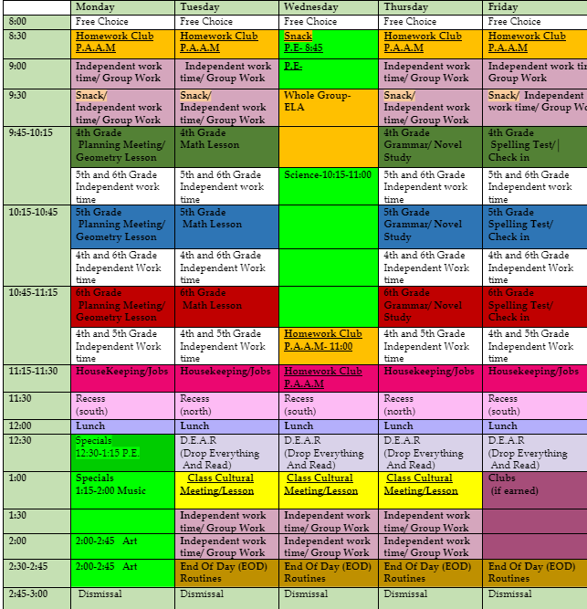
Schedule *This schedule may change due to special classes being added or other needed items Daily Lessons are found in Yellow and Green (4th grade), Blue (5th grade), and Red (6th grade) * note the end of the day meeting is not a lesson but students are still required to attend Daily, students will record in their planner notebook . Planar notebooks will include tasks, lessons, goals and other information about each academic school day.

Slide 8
Cultural Areas of Study 22-23
Geography
Fundamental Needs of Humans
Middle East
Africa
Asia
Europe
Central and South America
North America
History
Timeline of Life
Building Blocks of a Civilization
Ancient Civilizations
Mesopotamia
Egypt
India
China/Russia
Japan
Greece
Britain
Rome
Americas
Pacific Islands
Science
Organization of the Human Body
Study of Cells
Human Body Systems
Skeletal
Muscular
Digestive
Respiratory
Regulatory
Nervous
Circulatory
Reproductive

Slide 9
Google Classroom
A digital class material
Sarahfina’s Google Classroom Code:
https://classroom.google.com/c/NjE2OTc0OTQzMzIw?cjc=roh46iz
Stream
Will host weekly updates and musical messages.
At times announcements will be made in this area as well.
Classwork
Resources
Daily-Scudle and Planner
DEAR and Reading resources
Optional Project Proposal
HW resources
Assignments (M-F)
These are organized by days of the week.
Under each day, the daily assessments are listed by time, lesson
Each assignment has the instructions and follow up listed, and any materials used during the lesson.
Students can click the ‘View your work’ button and it lists when assignments were given, due dates, and if they are missing any work.
Assignments ( Week 1-38)
These organize the past assignments by week.

Slide 10
Homework:
Summer, Math, and Long term projects
We do not believe in assigning excessive homework. The homework that is assigned is meaningful and, for the average student, manageable. We feel it is important that it is completed as assigned so that students learn a sense of accountability. Homework is due every morning at 8:30am, Monday – Friday. Your support and help is deeply appreciated.
SUMMER HOMEWORK: All returning students were assigned review work to be completed over the summer. Students were expected to bring in their completed assignments on the first day of school. Should this homework not have been completed, students must complete it by the end of the first week.
MATH: Students will be given a Math Practice folder. Math practice starts August 11th, with the first lesson due Monday, August 14th.
For each lesson, students will complete the following:
Read the Lesson and Examples.
Complete all problems in the lesson.
Work should be organized, tidy, and show all solving steps.
Parents will be provided with a checking guide, and are asked to check and initial every lesson each night.
If a student misses 2 consecutive math homework assignments parents will be notified by the teachers.
If there is a pattern with missing homework, a meeting will be scheduled.
Each time a student comes to school without an assignment completed, they may be asked to work on it during recess or class time.
READING: Students are to read at least 20 minutes per night (no comic books or graphic novels unless teacher approved). Reading homework may include reading for research projects or the Art History Fair. Once a student completes a book, they may do a book report/project, present a book talk, or answer literature questions. Should the reading or assignments not be completed, students will read during recess or class time. If there are recurring times when this is not completed, the teacher will contact the parent.
PARENT SIGNATURES: Both the reading log and math lesson should be reviewed by parents and signed after corrections are made by the student. Solutions Manuals will be provided for the math practice homework.
LONG-TERM PROJECTS: Long term projects are broken down into steps, each with its own due date and corresponding point values. Meeting these due dates are essential for the completion of the project since it is completed over time. Points will be deducted for each missed due date. This year’s end project is the Great Lives Fair, which will be held in the second semester. The packet explaining requirements and expectations will be sent home late first semester.

Slide 11
Reading Homework Expectations
School Year Reading Homework Expectations:
Each month, students will have an assigned genre to read. Students are expected to complete and submit a book talk by the last Friday of the month (some months students will be expected to present their book talk). The book talk template will be given out in class.
The Following is a list of the genres by month. Please refer to this to help support your child in completing their required monthly book talks.
​ August: Folklore (a lesson and stories will be provided for this month)
September: Traditional Literature / Classics
October: Mystery
November: Historical Fiction
December: Informational / short nonfiction story about a culture of interest
January: Science Fiction
February: Biography/Autobiography of a Scientist (for our science fair)
March: Fantasy
April: Poetry
May: Choice
A link to help support you in choosing books
Reminder**A signature is required daily to receive credit for reading homework.

Slide 12
Classroom Notes
Academic day begins at 8:30 am and ends at 3:00 pm. Morning drop-off starts at 7:45 am for Academic day and 7:00 am for Circle.
You must drop-off or pick-up your child from the Main Office if arriving late or leaving early. 10 tardies is one absence, 18 absences is considered excessive by the Arizona Department of Education.
If your child will be absent please call the absentee line- (602) 955-2210 if you have a vacation planned during school days you need to inform Margo O’Neill so the absences can be considered excused. After 10 consecutive unexcused absences students are to be dis-enrolled.
Carline pick-up is at 2:55 – 3:30 pm. If you are later than 3:30 pm your child will be walked to the office and you will be charged a late fee. The drop-off, pick-up, and parking is the North parking lot. When leaving the school use the roundabout to exit on 28th street. Do not go into the East staff lot to drop off or exit.
If your child requires an Epi Pen or inhaler please provide one to store in the classroom. If your child must take medication during the school day, even over-the-counter, please bring it to the office in its original packaging and fill out the required forms for administration with the receptionist.
A non-disposable water bottle and placemats are needed for snack and lunch each day. Please remember to pack your child a fruit and vegetable daily. No soda or candy allowed. No edible treats on birthdays, if you would like to bring in a non-food item that is okay.
Please check your e-mail often for classroom and school-wide announcements. E-mail addresses and phone numbers should be updated as needed, if there is a change please notify the Main Office and Lead Teacher. I will be sending out a Newsflash weekly with class updates.
Please read the handbook with your children to go over the discipline policy and expectations for responsible behavior at school and in the classroom.
Please help your child follow the dress code as stated in the handbook.
Closed-toed shoes must be worn on every Monday and Wednesday for P.E., shorts inseam must be 3.5”, and no spaghetti strap tank-tops, visible under garments or offensive pictures or words.

Slide 13
A peek into the future….
Looking Ahead
Parent DEI intrest- Contact lead Eric Hammons
eehammons@gmail.com
Major fundraisers (Fun Run, Valentine Grams) , Winter Cookie Decorating, Helping Hands, Overnight trips, Auction Dinner, and more
Fundraising/Auction (Athena Moskoyes: amoskoyes@villamontessori.com)
Pizza Friday
Begins on Friday Sept 1st
Pizza Friday letters will be sent out Friday 8/11
Parent Coordinator will send out Pizza Friday sign up genius
pick up pizza
bring frust and veggies (optional)
Take home and Wash Laundry
Parent/Teacher Conferences
Goal Setting Conference- This is to discuss and create year long goals
September 22th and 29th
Progress Report- This is to examine academic and behavior progress
January 12th and 19st,
Optional End of the year conference -This is an as needed/requested conference.
May 10th
Student Progress reports will be sent home regardless of conference
Pollinator Garden Expansion

Slide 14
Frequently Asked Questions
Lunch and snacks
Students will have lunch and snack within the classroom setting
Students will wash hands before and after eating
Students will use a place mat daily during lunch and snack times
E2 Specials
Monday afternoon
PE
Art
Music/Computer
Wednesday morning
PE
Science
Technology use in the classroom
Students may bring in their own devices to use for research and typing papers at their own risk. While we have limited devices in the classroom, we should have the ability to check out devices throughout the school year as needed.
Teachers and parents are no loner permitted to communicate via cell phone. Please contact me through my e-mail at sfore@villamontessori.com
Overnight Trips
More information will be provided at a later date :)
Villa Calendar
https://4.files.edl.io/b5a4/07/07/22/170316-6d2541e2-853c-45fd-aa51-49d45495d7b2.pdf

Slide 15
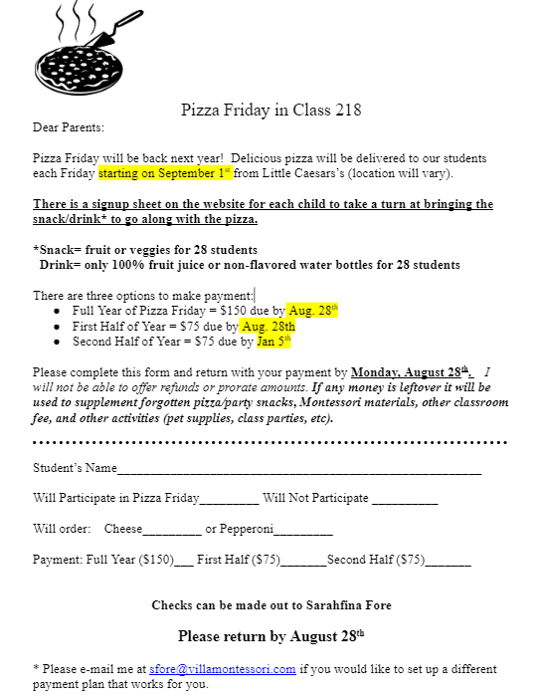
Pizza Friday

Slide 16
* notes from
Christy & Margo
(Heads of School)
Arriving to Campus
Campus is open at 7:45. If you are looking to drop off students earlier, they will need to be apart of our before/after care program called “circle”.
The gates will be locked at 8:30. If a parent arrives at 8:30 or after, they need to drive their child to the office to sign in.
Volunteers are used on an as needed basis and should check-in to the office and get a visitor badge.
Carline/ Leaving Campus Reminders
Ideally, student leaving early would leave prior to 2:30. We understand sometimes there is a need to pick up between 2:30-3, but not often preferably.
No one should park on Meadowbrook (the street between ECC and Elementary) to pick up their child. We have an agreement with the neighborhood that we will not have parents parked there. Carline usually takes about 20 min. If they would prefer to just drive up and get their child rather than wait, they can arrive at 3:15.
Please ask parents to use their name tag the entire year AND the whole time they are driving through the carline. We have people that call from the area with the students as a backup.
The walking gate is for students walking to the middle school for pickup because they have a sibling there or because they live in the neighborhood.
If a child is doing something different than they typically do after school (walking, going to circle, going home with another child) they need a "Ticket to Ride" which should be communicated 24 hours in advance or sent in the communications folder.
Parents must use the turnaround at the end of the parking lot and exit on 28th street to the right. Please look for students walking across the parking lot crosswalk. They should not exit through the staff lot onto Meadowbrook.

Slide 17
With Gratitude…

